Slide 1
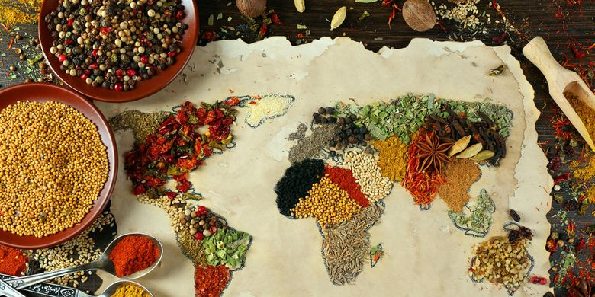
Cuisine du monde
BOUCHIKHI Taha
LOEILLET Amaury
MARSAN Florian
MOLINARES Diógenes PERCHAPPE Marine

Slide 2

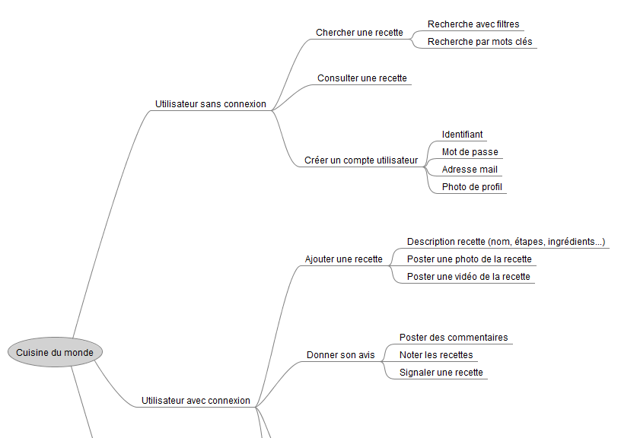
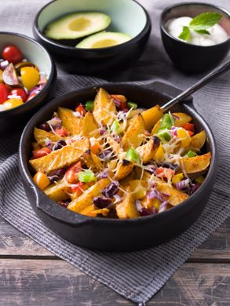
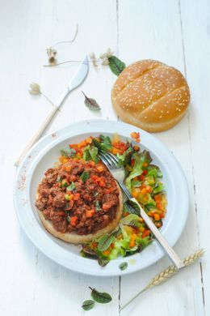
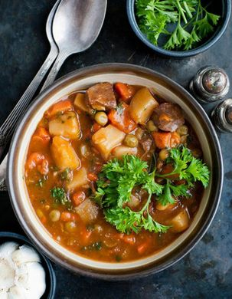
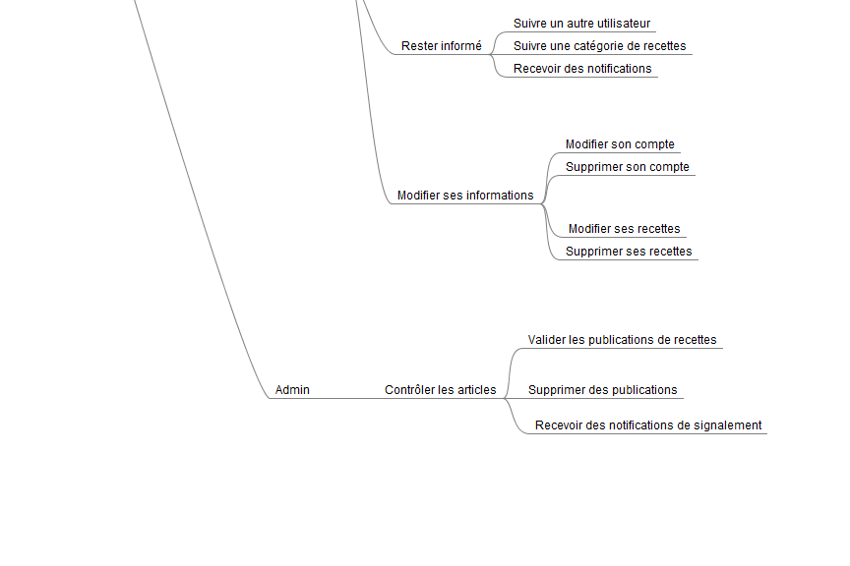
Impact mapping

Slide 3
Backlog

Slide 4
User Story

Slide 5
Technologie

Slide 6
Risques

